Slide 1
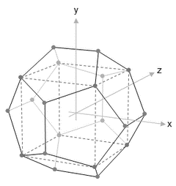
NISRA
Data Science Bootcamp
WELCOME
Course Title – Week 7 Python for Data Science
Course Tutor: Ashish Kumar
30th Jan – 3rd Feb 2017

Slide 2
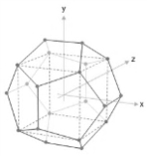
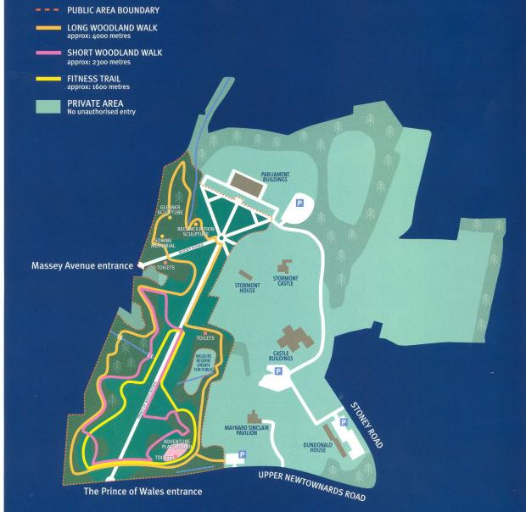
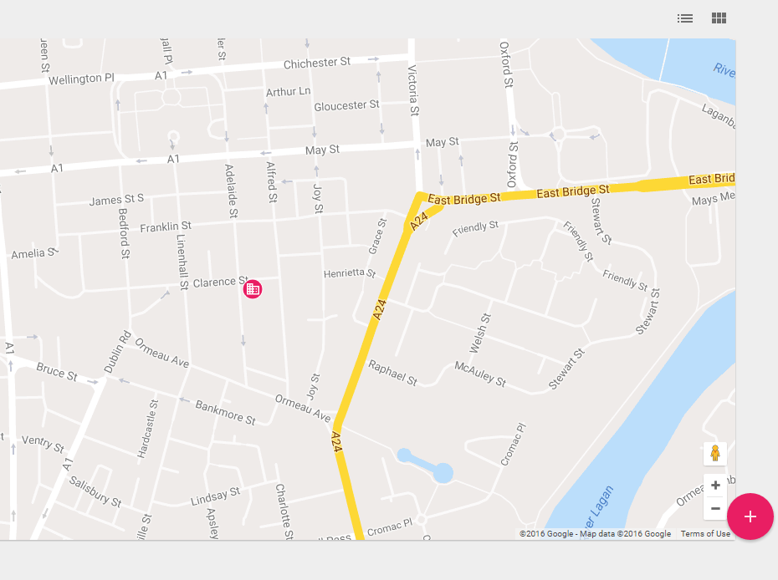
Course Locations
Location 1: ‘The Stables’, Stormont Castle
Location 2: ‘iD Lab’, Adelaide Street, Belfast

Slide 3
Your Attention Please
Fire Alarm
There are no fire alarm tests scheduled for today. So, if you do hear the fire alarm siren, or announcements asking you to leave the building, please leave immediately by the nearest available exit.
Staff in high visibility jackets will direct you to the assembly point.
Please take a moment to locate the exits around you now.
Toilets
The NISRA Stables Training Room toilets are located
The Intelligent Datalytics toilets are located on your left as you enter the office.
Refreshments
The NISRA kitchen for coffee and tea is available
Vending machines are available for refreshments on the 1st Floor of the Premier Business Centre.

Slide 4
Content Summary
Day 1 | Introduction to Python | Details | Start | End | Format
 | Python Basics | Characteristics & Capabilities Few Case studies Libraries in Python Distributions & IDEs of Python Python Installation Installing a package | 09:00 | 10.30 | Taught
 | Python Basics | Data Structure Types: List/Tuples/Series/Dictionaries/DataFrame/ Loops: For/If-Else/While List Comprehension Writing functions | 10.45 | 12.15 | Taught
 | Python Basic Lab1 | Solving problems using loops, functions & data types | 13.00 | 14.30 | Practical
 | Python Basics Lab2 | Solving problems using loops, functions & data types | 14.45 | 16.15 | Practical
 | Wrap up / Q & A Discussion |  | 16.15 | 16.45 | Q&A

Slide 5
Content Summary
Day 2 | Data preparation with Python 1 | Details | Start | End | Format
 | Reading/Writing data | Understanding a DataFrame Basics of Pandas Reading a dataset: CSV, JSON, URL,XLSX Connecting to a databases | 09:00 | 10.30 | Practical
 | Data Explorations | Preview of the read dataset Basic Stats / Data types of the dataset Data type conversion | 10.45 | 12.15 | Taught
 | Python Basic Lab1 | Sub-setting a Dataframe Creating a new /renaming column in Dataframe Writing data to a csv file | 13.00 | 14.30 | Practical
 | Data Wrangling | Handling missing values Sort a dataset Transpose dataset | 14.45 | 16.15 | Practical
 | Wrap up / Q & A Discussion |  | 16.15 | 16.45 | Q&A

Slide 6
Content Summary
Day 3 | Data preparation with Python 2 | Details | Start | End | Format
 | Data Transformation | Identifying unique values Removing duplicate values of a variable Sample rows from dataset Creating a simulation | 09:00 | 10.30 | Practical
 | Data Transformation | Aggregating a function (Groupby) Applying functions | 10.45 | 12.15 | Taught
 | Data Transformation | Merging datasets Pivot tables | 13.00 | 14.30 | Practical
 | Data Transformation | Lag & Rolling functions Creating a dummy variable Creating a dataset | 14.45 | 16.15 | Practical
 | Wrap up / Q & A Discussion |  | 16.15 | 16.45 | Q&A

Slide 7
Content Summary
Day 4 | Data visualization & NLP with Python | Details | Start | End | Format
 | Visualisation with Matplotlib | Sample visualization with matplotlib – boxplots, histograms, scatter plot etc. | 09:00 | 10.30 | Practical
 | Visualisation with Seaborn | Sample visualization with Seaborn – boxplots, histograms, scatter plot etc. | 10.45 | 12.15 | Practical
 | Visualisation with Plotly | Sample visualization with plotly – boxplots, histograms, scatter plot etc. OR Introduction to NLTK | 13.00 | 14.30 | Practical
 | NLTK continued | Continued Introduction to NLTK | 14.45 | 16.15 | Practical
 | Wrap up / Q & A Discussion |  | 16.15 | 16.45 | Q&A

Slide 8
Content Summary
Day 4 | Data visualization & NLP with Python | Details | Start | End | Format
 | Visualisation with Matplotlib | Sample visualization with matplotlib – boxplots, histograms, scatter plot etc. | 09:00 | 10.30 | Practical
 | Visualisation with Seaborn | Sample visualization with Seaborn – boxplots, histograms, scatter plot etc. | 10.45 | 12.15 | Practical
 | Visualisation with Plotly | Sample visualization with plotly – boxplots, histograms, scatter plot etc. OR Introduction to NLTK | 13.00 | 14.30 | Practical
 | NLTK continued | Continued Introduction to NLTK | 14.45 | 16.15 | Practical
 | Wrap up / Q & A Discussion |  | 16.15 | 16.45 | Q&A

Slide 9
Content Summary
Day 5 | Predictive Analytics with Python | Details | Start | End | Format
 | Introduction to other useful packages | Linear Algebra with Python Introduction to scikit-learn | 09:00 | 10.30 | Practical
 | Project 1 | Sample Project 1 (Linear Regression with sciki t learn) | 10.45 | 12.15 | Practical
 | Project 2 | Sample Project 2 (Text Classification using Naïve Bayes) | 13.00 | 14.30 | Practical
 | Project 3 | Sample Project 3 (Optimal Demand Forecasting using Newsvendor model) | 14.45 | 16.15 | Practical
 | Wrap up / Q & A Discussion |  | 16.15 | 16.45 | Q&A

Slide 10
Day 1: Python Basics
Introduction to Python
Data Science packages in Python
IDEs in Python
Downloads and Installations
Data Structure Types
Control Statements
Problem Solving using Python

Slide 11

Introduction to Python
Open Source
Variety of powerful & elegant IDEs
Intuitive syntax; simple to use
Easy debugging; errors and packages well-documented
Creating GUIs, connecting to relational databases etc.
Scientific computing packages-LinAl, 3D, Simulations
Can read data into chunks-essential to read large datasets
Variety of packages for Data Science
Can be easily integrated with other APIs and coding languages

Slide 12
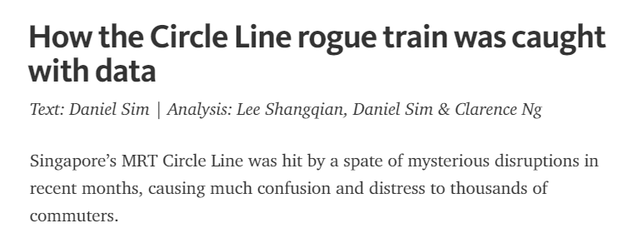
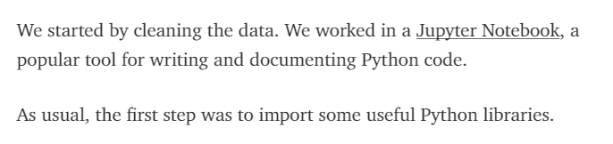
Introduction to Python
Case Study 1
Read the full article

Slide 13
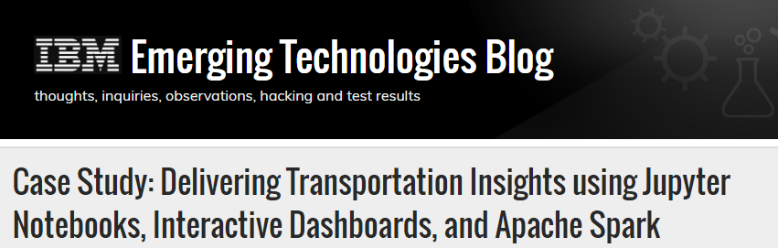
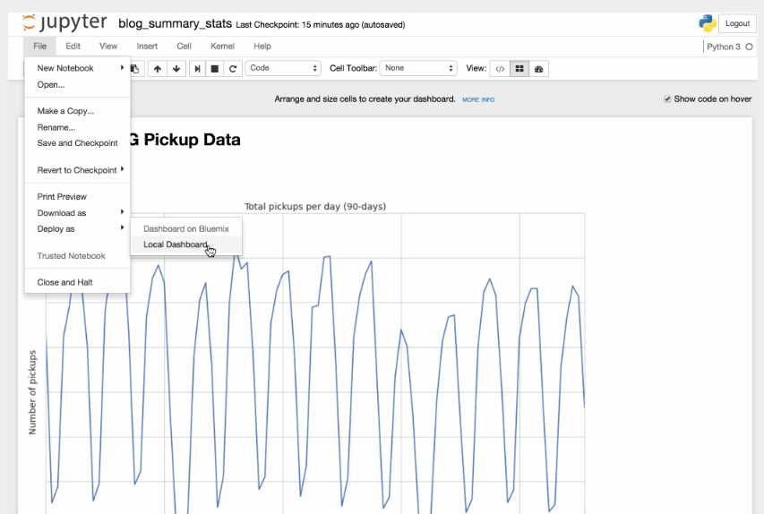
Introduction to Python
Case Study 2
Read the full article

Slide 14
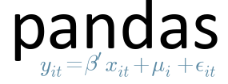


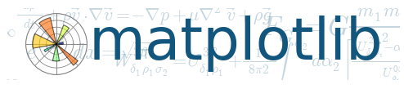
Data Science packages in Python
Most important and versatile package used widely in data science domains
Following are the main features of this package:
reading of a dataset in a usable format (Data Frame in case of Python),
calculating basic statistics and,
basic operations: sub-setting a dataset, merging/concatenating two datasets, handling missing data etc.
MATLAB equivalent in the Python environment
Following are the main features of this package:
a powerful and widely used a N-d array element
mathematical functions used in linear algebra, Fourier transforms and random number generation
dummy datasets, simulations.
A robust collection of all the data science algorithms and methods to implement them
Following are the main features of this package:
built entirely on Python packages like pandas, numpy and matplotlib
methods for implementing most of the data science techniques like Linear regression, logistic regression, clustering and decision trees
concise method to predict the outcome based on the model and measure the accuracy of the outcomes
Used to generate high quality plots
Following are the main functions of this package:
common plots viz. histograms, stacked and unstacked bar charts, scatterplots, heat diagrams, box plots, power spectra, error charts etc.
edit and manipulate all the plot properties like title, axes properties, color, scale etc.

Slide 15
IDEs in Python
IDE or Integrated Development Environment is a software which provides the source-code editor cum debugger for writing code. Using these softwares, one can write, test and debug a code snippet before adding the snippet in the production version of the code.
IDLE
Jupyter
Spyder
Default IDE for Python and comes with default implementation of Python
Following are the main features of this IDE:
Multi-window text-editor with auto-completion, smart-indent and syntax and keyword highlighting
Python shell with syntax highlighting
IDE for beginners as it is simple to use and works well for simple tasks
A powerful computational environment where code, execution, results and media can co-exist in one single document
Following are the main features of this package:
code, executions, plots and results stored in different cells can be saved and edited as and when required
Inline figure rendering of matplotlib plots which can be saved in multiple formats(JPEG,PNG)
Standard python syntax in the notebook can be saved as a python script
Spyder is a powerful scientific computing & development environment for Python
Following are the main features of this package:
Advanced editing, auto-completion, debugging, interactive testing
Python kernel and code editor with line numbering in the same screen
Pre-installed scientific packages like numpy, pandas, scikit-learn, matplotlib etc.

Slide 16
Downloads and Installation
Name | Function | Link
Python v2.7.0 | Python Installation | https://www.python.org/downloads/
Anaconda | Python Distribution | https://www.continuum.io/downloads
Pip | Package Installer | https://pip.pypa.io/en/stable/installing/
• Anaconda (Python distribution) should be installed
• Download Anaconda from - https://www.continuum.io/downloads
• Download the Python 2.7 version. It is more stable. Go to Control Panel-> System and Security to check the operating system type (32/64 bit). Download the appropriate installer.

Slide 17
Demo
Demo of Jupyter Notebook

Slide 18
Data Structures in Python
List
holds an ordered collection of items
items separated by commas
enclosed in square brackets
mutable (can add/delete elements)
Prezlist = [‘Higgins’, ‘Modi’, ‘Trump’, ‘Putin’, ‘Merkel’]
Prezlist.append(), prezlist.sort(), len(prezlist), del prezlist[0] (indexing)

Slide 19
Data Structures in Python
Tuple
Similar to list
immutable
enclosed in parentheses (optional)
mat = (‘land’, ‘water’, ‘air’)
got = ‘fire’, ‘ice’, mat = ‘fire’, ‘ice’, (‘land’, ‘water’, ‘air’)
got[2], got[2][2]

Slide 20
Data Structures in Python
Dictionary
key-value pairs
d = {key1 : value1, key2 : value2 }
capital={'India':'New Delhi', 'Ireland':'Dublin', 'USA':'Washington DC','France':'Paris'}
capital[‘India’], capital.items(), del capital[‘India’], capital[‘Australia’]=‘Sydney’

Slide 21
Data Structures in Python
Array
multidimensional container for homogeneous data
Numpy package has the method to create powerful arrays
data1=[1,3,7,91], ar1=np.array(data1); data2=[[1,2,3,4],[5,6,7,8]], ar2=np.array(data2)
np.zeros(10), np.ones(15), np.ones(15).reshape(3,5)
ar2[0][1], ar1[1:3]

Slide 22
Data Structures in Python
Data Frame
Most common data structure in Python
Similar to SQL table or a spreadsheet
Creating data frame from array
import pandas as pd
data=[(1,2.,'Hello'), (2,3.,"World")]
df1=pd.DataFrame(data,columns=['A','B','C'])
Creating data frame from list of dicts
data2 = [{'a': 1, 'b': 2}, {'a': 5, 'b': 10, 'c': 20}]
df2=pd.DataFrame(data2)
Creating a data frame by reading a csv/txt file

Slide 23
Control Statements in Python
For loop
for i in range(10):
for j in range(5,20):
print(i*j)
import string
alphas=string.lowercase
alphal=[]
for i in range(len(alphas)):
alphal.append(alphas[i])
for keys, values in dict.items():
Print keys, values

Slide 24
Control Statements in Python
While loop
while True:
input('Enter something')
i=0
while i<6:
print i
i=i+1
x=0
while x<10:
x+=1
print x<10
print x

Slide 25
Control Statements in Python
If – Else
a=input('Enter a number:\n')
if(a%2==0):
print('You entered an even number')
else:
print('You entered an odd number')
lat=input('Enter the latitude of the number:\n')
if lat>180 or long<-180:
print('An invalid latitude!')
else:
print('Valid latitude!!')

Slide 26
Control Statements in Python
List comprehensions
c=[a+b for a in range(10) for b in range(5) if a+b>4]
prod=[i*j for i in range(10) for j in range(5,20) if i>5 and j>10]
capital={'India':'New Delhi', 'Ireland':'Dublin', 'USA':'Washington DC','France':'Paris'}
[(keys,values) for keys,values in capital.items()]

Slide 27
Control Statements in Python
Functions
def squaresum(x,y):
return(x*x+y*y)
squaresum(3,4)
def areatriangle(a,b,c):
s=(a+b+c)/2
area=pow((s*(s-a)*(s-b)*(s-c)),0.5)
return(area)
areatriangle(3,4,5)
def zipper(a,b):
c=[(a[x],b[y]) for x in range(len(a)) for y in range(len(b)) if x==y]
return c

Slide 28
Problem Solving using Python
Q1. Find sum of first n odd natural numbers

Slide 29
Problem Solving using Python
Q2. Find the sum of numbers which are multiples of either a or b up to a limit

Slide 30
Problem Solving using Python
Q3. Create a dictionary with 10 values in each key

Slide 31
Problem Solving using Python
Q4. Generate the Fibonacci sequence till number n

Slide 32
Problem Solving using Python
Q5. Find Pythagorean triplets up to a number n

Slide 33
Problem Solving using Python
Q6. Create the quadratic equation solver

Slide 34
Problem Solving using Python
Q7. Finding the cumulative sum of a list

Slide 35
Problem Solving using Python
8. Reversing elements of a list

Slide 36
Problem Solving using Python
Q9. Find the lines in a file containing an expression

Slide 37
Problem Solving using Python
Q10. Finding the moving average of a list

